Slide 1
Creating a natural human model

Slide 2


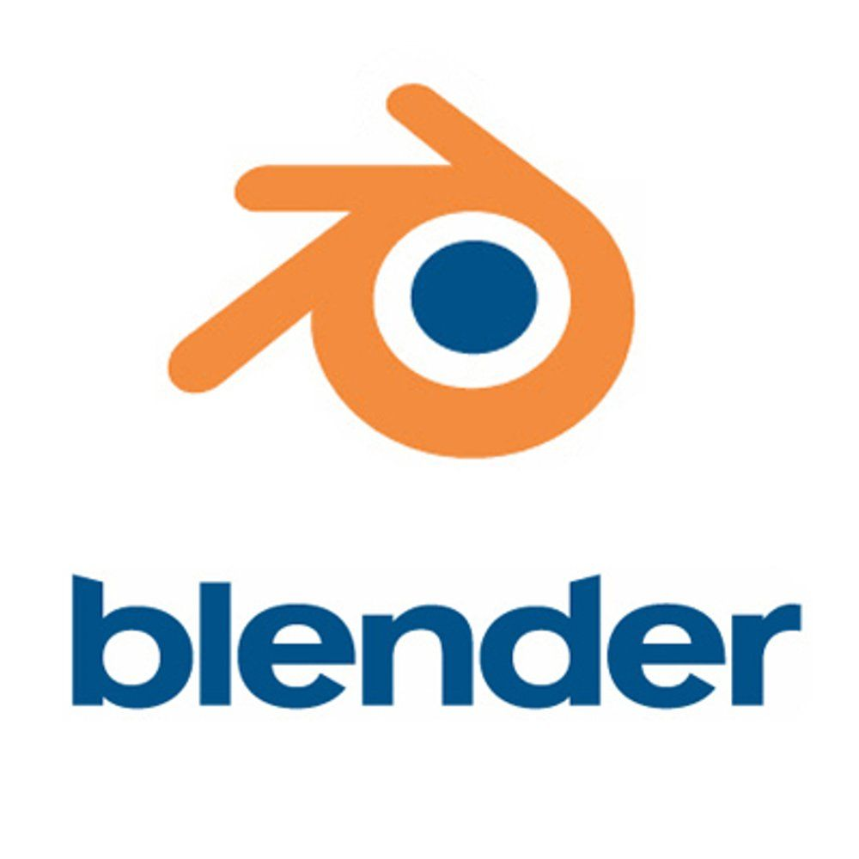
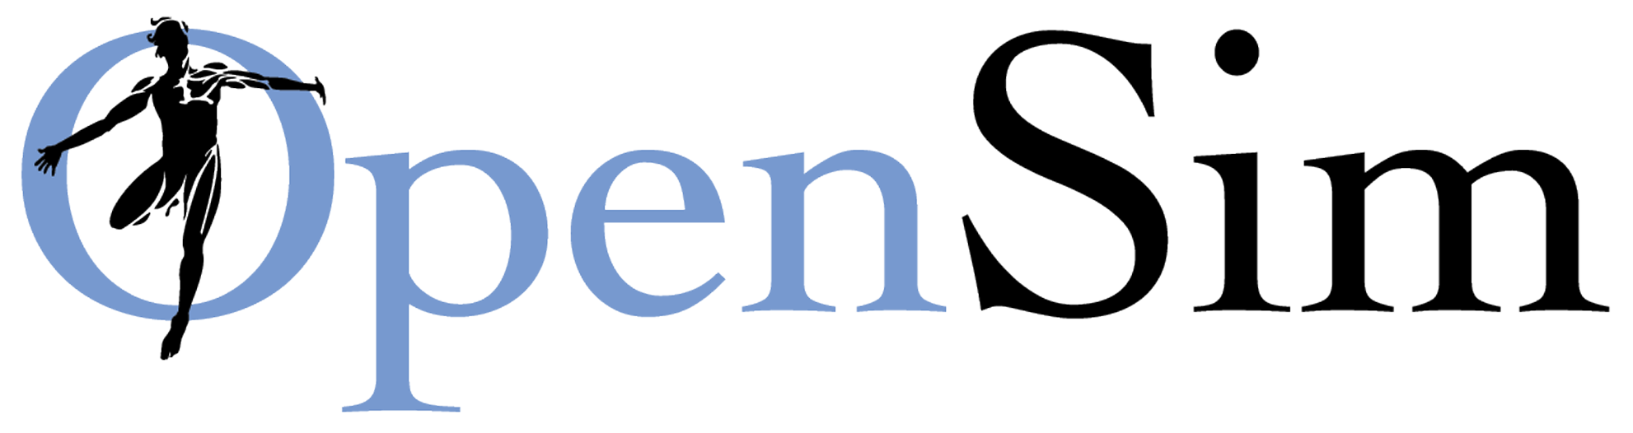
Create
Simple approach
Standard CG approach
Sophisticated approach

Slide 3
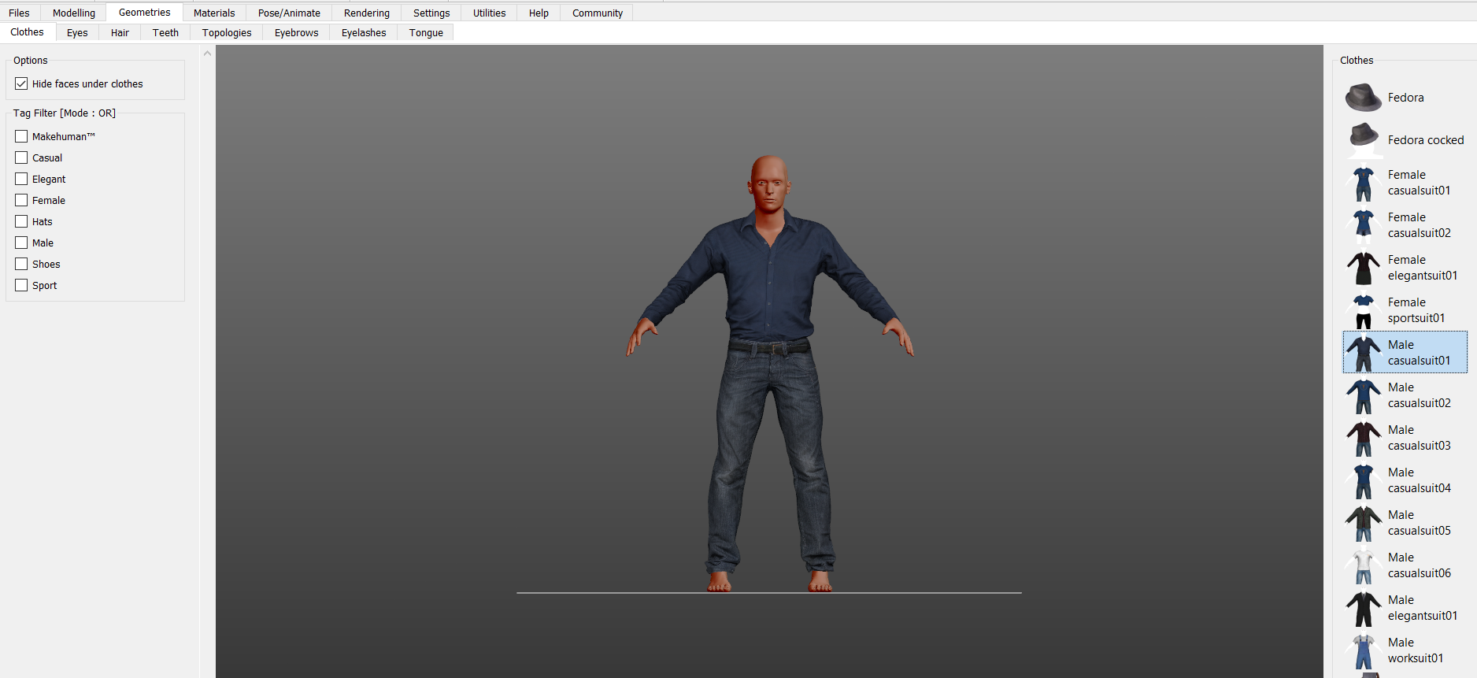
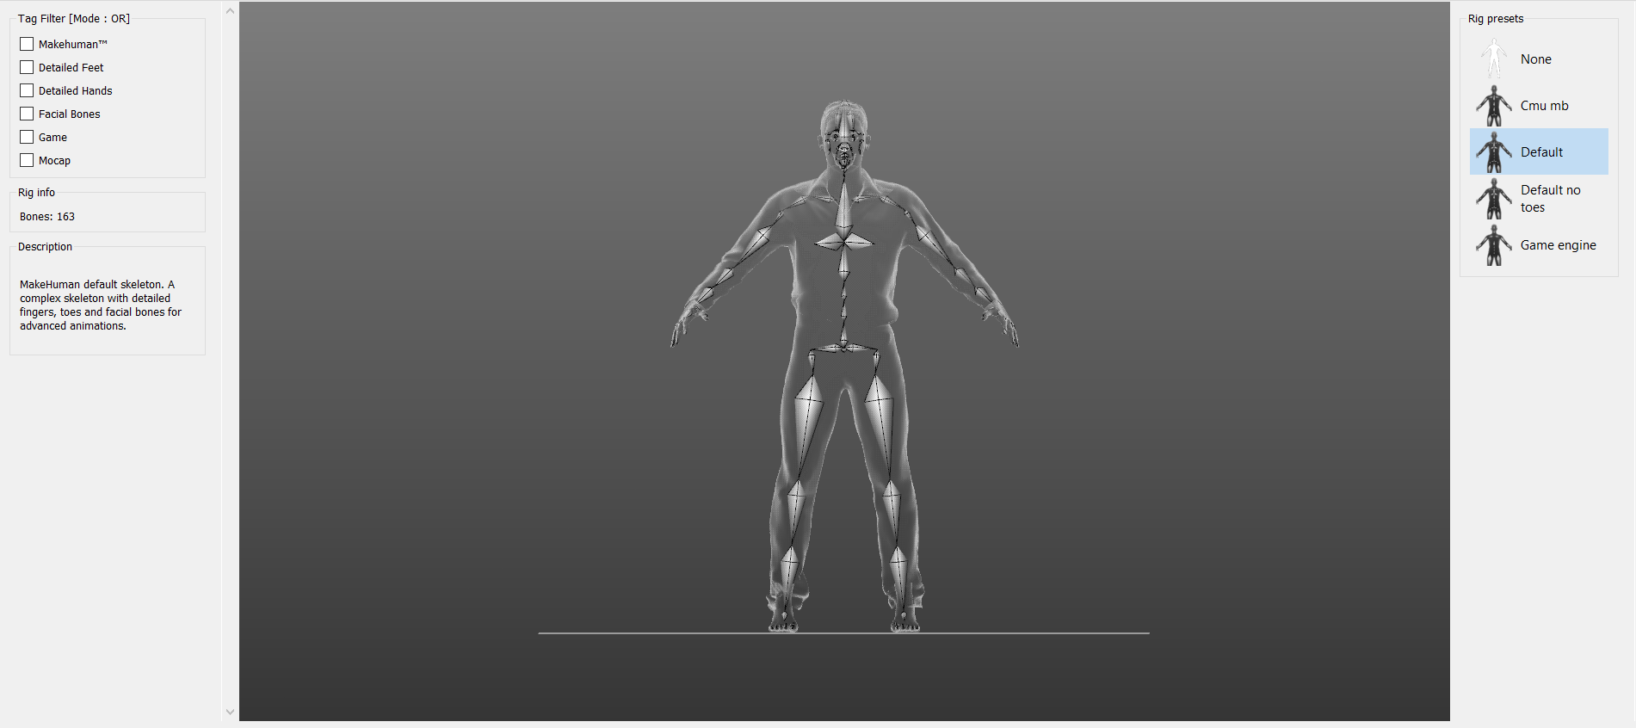
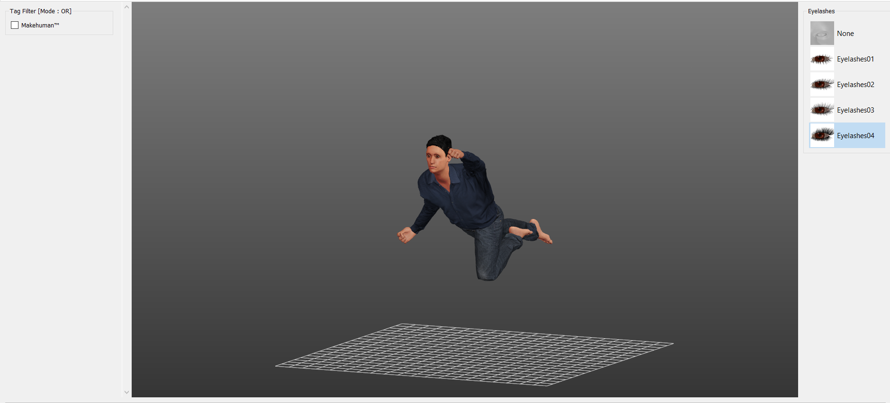

MakeHuman
The simplest process
Open-Source tool.
Allows to create a model including texturing, rigging and changing topologies
Export to different formats including:
.fbx
.obj
.bvh
.glb
Many others

Slide 4
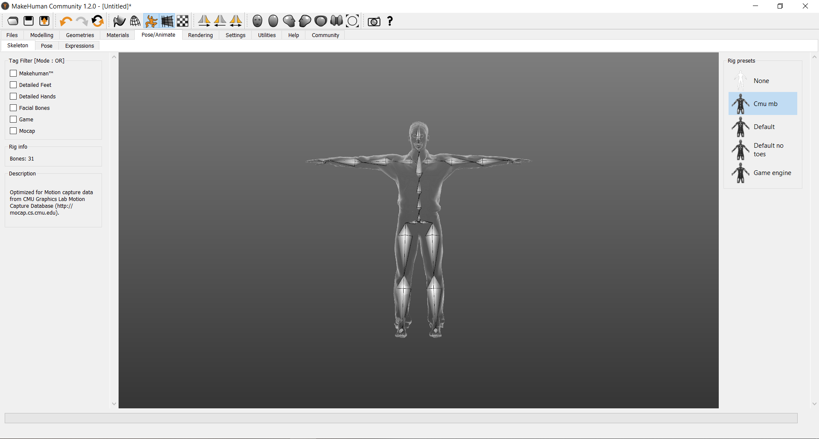
Automatic rigging
4 available skeletons
Different complexity

Slide 5
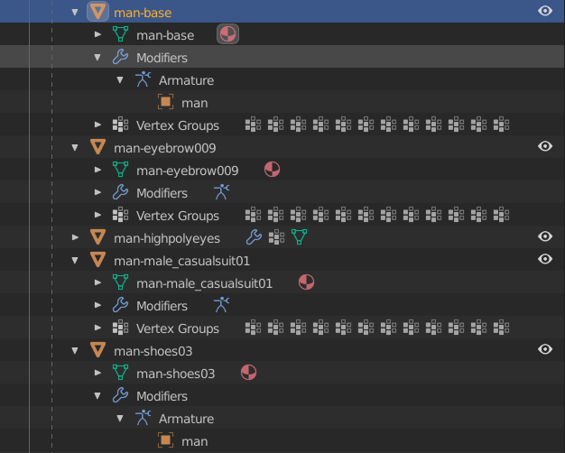
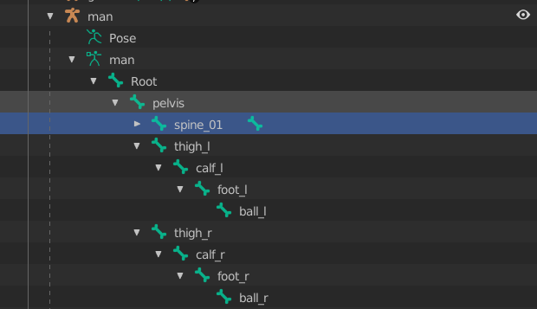
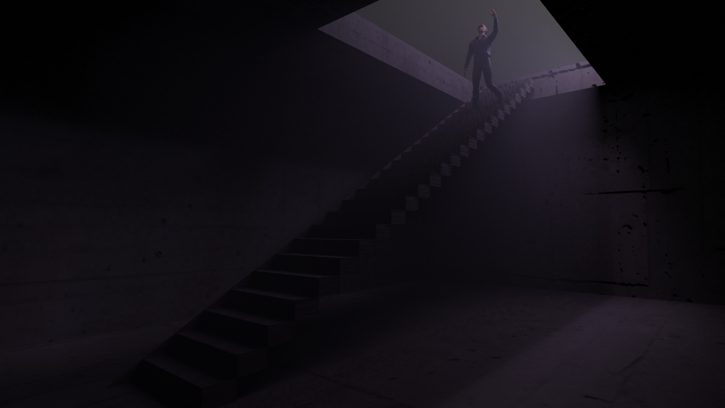

Transfer to Blender
Scenes are easily convertible to .gltf format to use in framework like Babylon.js

Slide 6
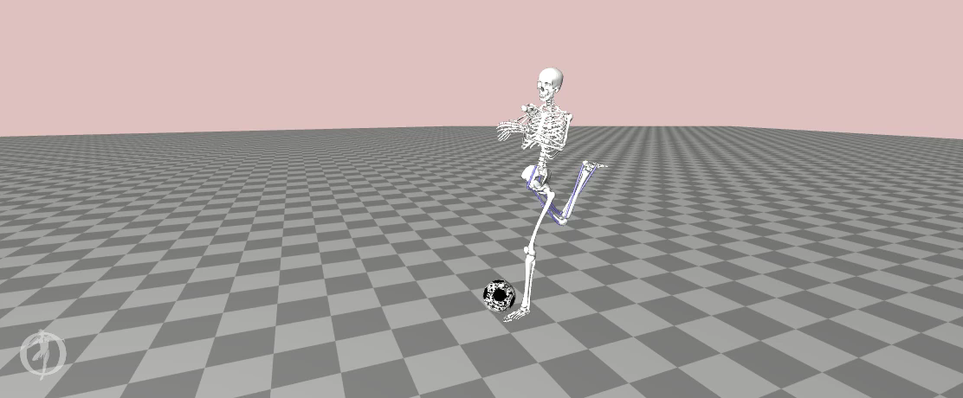
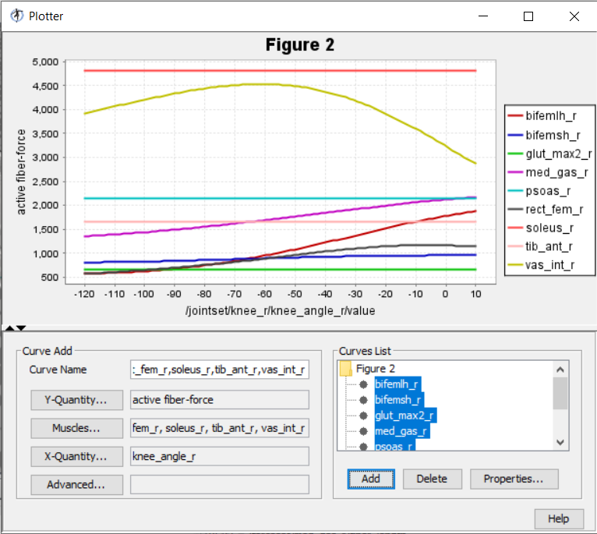
OpenSim
Complex approach
OpenSim is a professional software for medical and ergonomic analysis.
It allows to analyze muscles and joints as a system

Slide 7
Motion Capturing

Slide 8
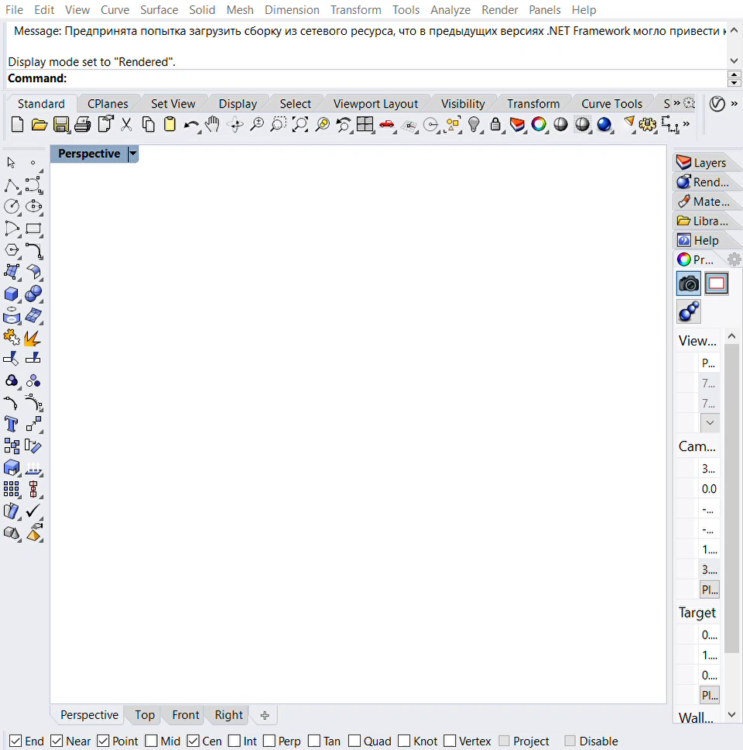
Kinect SDK
Free addons for Rhinoceros + Grasshopper
The SDK can be used to create a motion capture files using Rhinoceros and Grasshopper.
It is also possible for different applications doing motion capturing using Kinect.

Slide 9
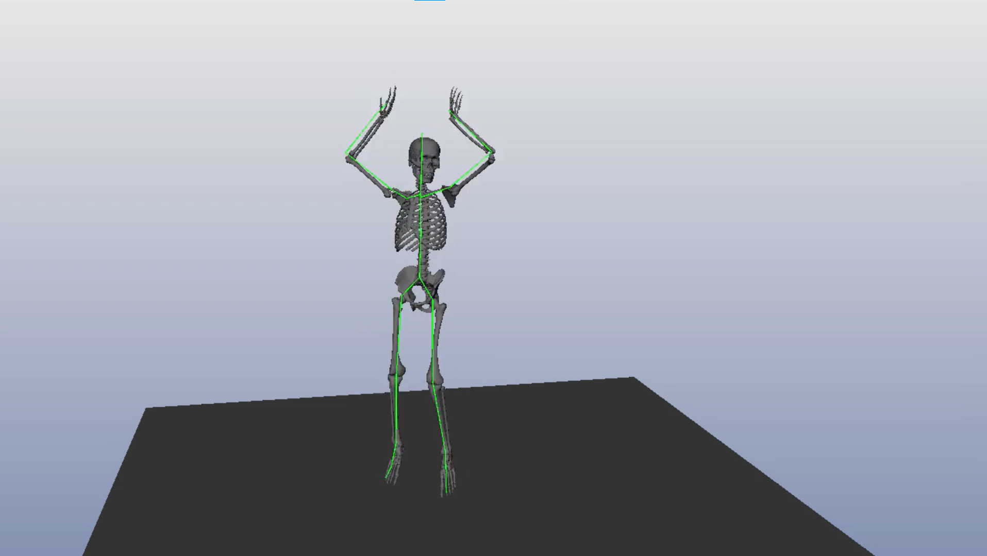
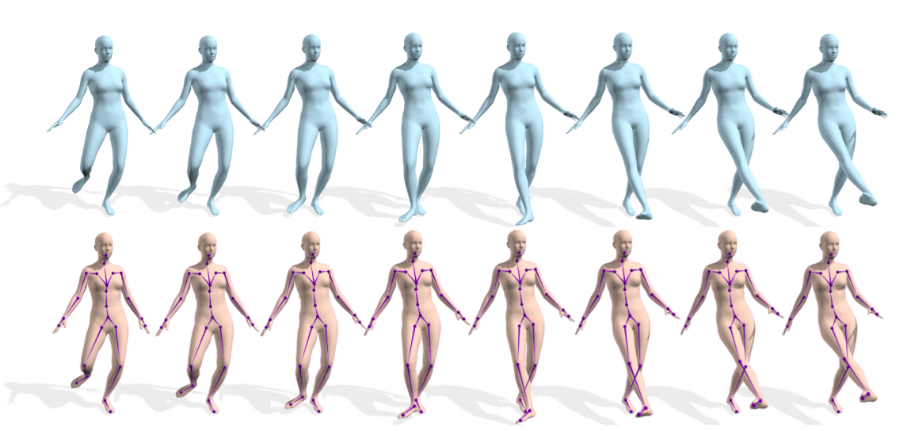
Pose Estimation AI
Pose estimation algorihms are the step in the process of object detection-segmentation-estimation pipeline
Algorithms are able to reconstruct human motions in 3D environment
Models are trained using large datasets and are already precise enough

Slide 10
Possible Custom Substitute of OpenSim
Creating the tension and interaction analysys tool using Rhino and Grasshopper

Slide 11

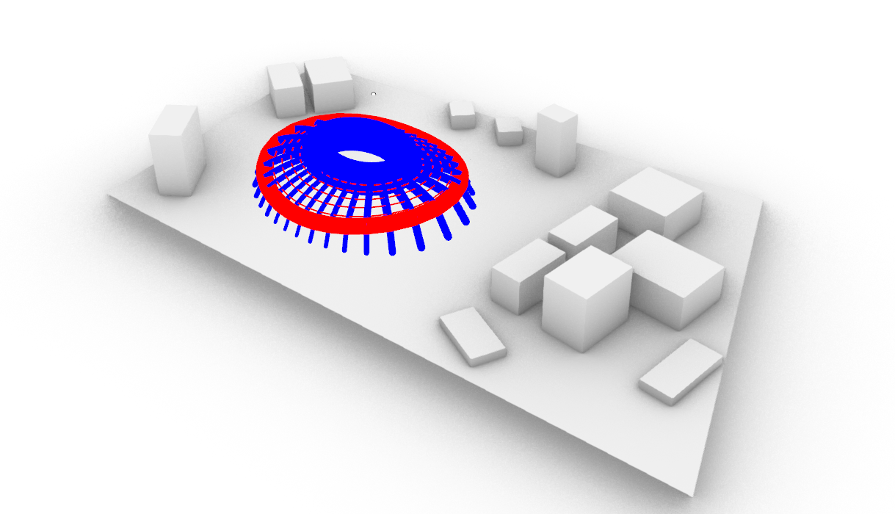
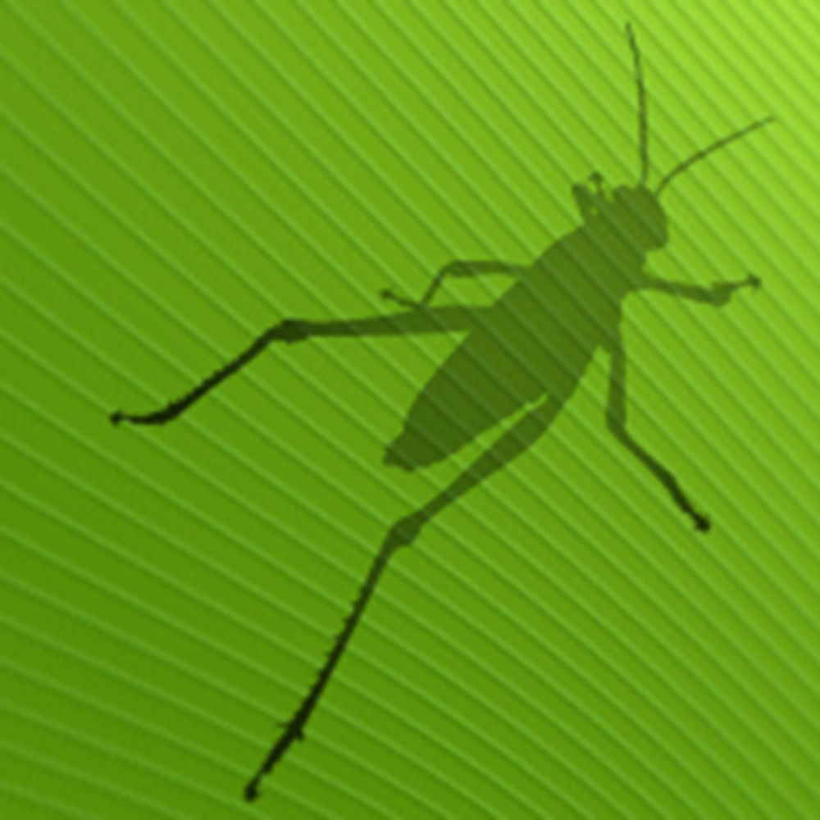
Starting from a Kinect sourced model

Slide 12
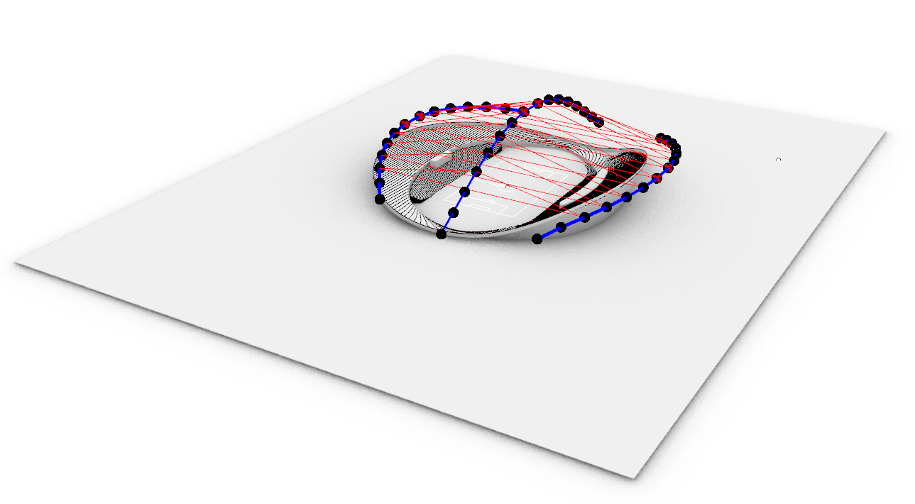
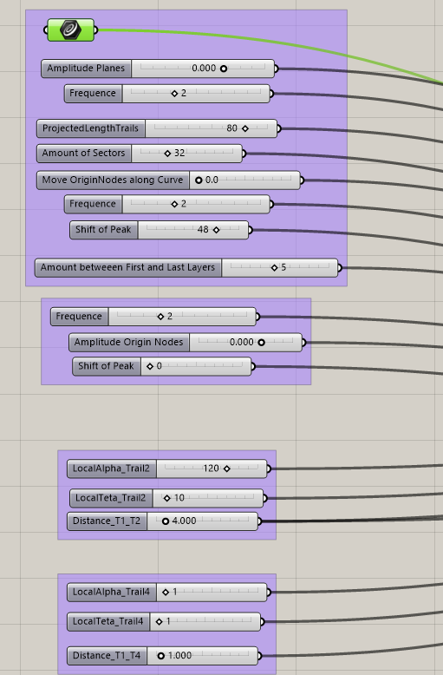
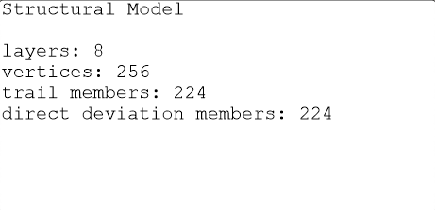
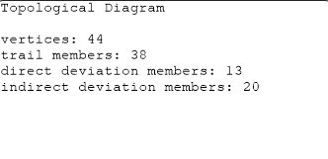
The Idea
Combination of Kinect SDK Skeleton and structure analyser from a custom civil engineering scripts

